Slide 1
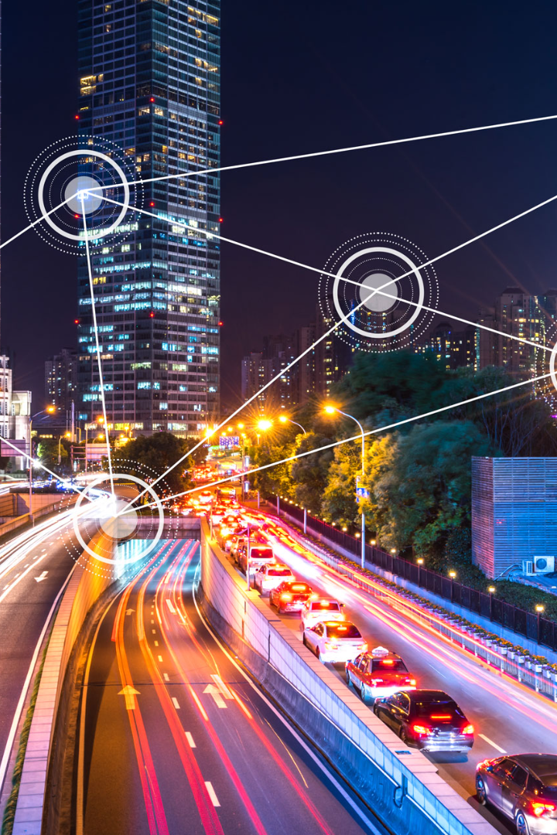

Public Transportation in IoT Development
Explore the fascinating world of IoT technology and its impact on the development of public transportation systems.
CA
by CHINNATHAI A

Slide 2

Benefits of Incorporating IoT in Public Transportation
1
Enhanced Safety & Security 🛡️
2
Optimized Operations 🚀
Real-time monitoring and surveillance systems help ensure a safer and more secure commuting experience for passengers.
IoT enables predictive maintenance, efficient route planning, and effective fleet management, resulting in reduced costs and improved operational efficiency.
3
Real-time Passenger Information 📱
Passengers can access accurate and up-to-date information about arrival times, delays, and even seat availability to plan their journeys effectively.

Slide 3
Challenges and Limitations of IoT in Public Transportation
Data Security Concerns 🔒
Infrastructure Requirements 🏗️
Integration Complexity 🧩
The increase in connected devices introduces potential vulnerabilities, highlighting the need for robust security measures to protect sensitive information.
Implementing IoT in public transportation requires the necessary infrastructure, including reliable connectivity and data processing capabilities.
Integrating various IoT devices, systems, and protocols can be complex and challenging, requiring careful planning and coordination.

Slide 4
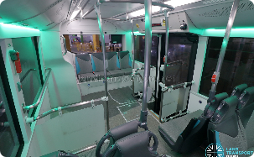
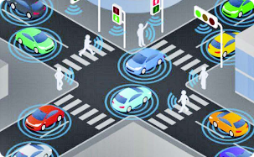
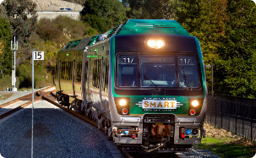
Case Studies: Successful Examples of IoT in Public Transportation
Smart Buses
Connected Traffic Infrastructure
Smart Train Stations
IoT-enabled buses equipped with smart sensors and real-time tracking systems have significantly improved operational efficiency and passenger experience.
Modern train stations leverage IoT to provide seamless connectivity, automated ticketing, and personalized passenger experiences.
Intelligent traffic management systems powered by IoT technology help optimize traffic flow, reduce congestion, and minimize travel times.
def sys_init(): global loraM, client obtain_port()
#Twilio Client Initilize client = Client(ACCOUNT_SID, AUTH_TOKEN) print("Primary Comm Mode, Twilio Sync Initialized\n") # LoRa module Initialze on the given Port loraM = MCLoRa(port) success = loraM.testOK() if success: print("Secondary Comm Mode, LoRa RF Initialized\n") print(success) print(loraM.getUniqueID())

Slide 5
Impact of IoT on Improving Efficiency and User Experience
1
Real-time Data Insights
IoT enables the collection and analysis of vast amounts of real-time data, empowering transportation authorities to make data-driven decisions for better efficiency.
Personalized Services
2
Through IoT, public transportation can offer personalized services such as customized route recommendations, fare options, and targeted notifications.
3
Improved Accessibility
IoT solutions ensure that public transportation is accessible to everyone, including individuals with disabilities, by providing real-time accessibility information and assistance.
def systemInit():
4
global port, loraM, client obtain_port() gpio_init() emergencyVehicleState.setdefault("state",0) #loraM handles all the loraEvents loraM = MCLoRa(port) success = loraM.testOK() if success: print "Traffic Controller Gateway Init Success" print (success) else: print("Traffic Controller Gateway Init FAILURE") loraM.pause() #Twilio Client client = mqtt.Client(client_id="rpi", clean_session=False) client.tls_set(None, pem_location, key_location) client.on_message = handleEmergencyMessage # # Use qos=1 to get your device caught up right away. # client.connect('mqtt-sync.us1.twilio.com', 8883, 60) client.subscribe('sync/docs/gpsData', qos=1) client.loop_start()

Slide 6

Future of Public Transportation in the Era of IoT
1
Autonomous Vehicles 🚗
2
Smart Integration 🌐
The integration of various smart systems, such as smart grids and smart buildings, will create a seamless and interconnected urban transportation ecosystem.
The convergence of IoT and autonomous vehicles will revolutionize public transportation, offering safer and more efficient travel experiences.
3
Improved Sustainability ♻️
IoT-enabled public transportation will contribute to reducing carbon emissions by optimizing routes, promoting electric vehicles, and encouraging shared mobility.

Slide 7

Conclusion and Key Takeaways
IoT technology holds immense potential for transforming public transportation, improving efficiency, enhancing user experience, and shaping the future of urban mobility.

